Slide 1
KOKO Product Tracking and Versioning [Updated]

Slide 2
Objective
Objective of this document is to agree the process to the manage the versions of the KOKO products while doing any changes in the Engineering and BOM and any other minor changes in the Raw materials used.
As KOKO both manufactures the product [In India] and Sell them [In Kenya Market] and also assembles the products in the Kenya [e.g. koko points and SDS], we need look into all the possibilities of BOM changes of the products in KOKO ecosystem and management for the same.

Slide 3
Versioning Requirement In India

Slide 4
Requirement for Versioning in India
KOKO in concept is a growing company and we are in the process of improving our product quality based on the consumer feedback, Market research and most importantly as a self evolution program to make our products safer and consumer friendly. To achieve this goal the KNI Engineering team do changes in the Engineering drawing and based on the change in the RAW materials team needs to change the Product BOM as well.
At present the Versioning Mechanism does not exist in the system and the process is all manual and we can not manage the BOM history in the changes done in the BOM. With versioning we can maintain the full change history of the Product BOM and compare them if required in the future. Also by configuring the propercosting we can also generate the cost structure of the Product and compare pricing as well.

Slide 5
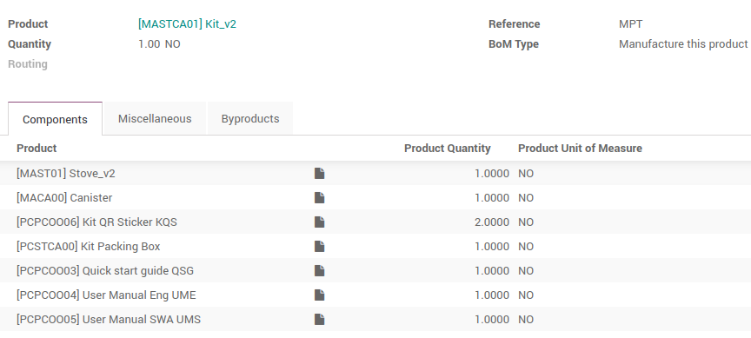
Product BOM
The Product BOM and the Engineering drawing are managed in India Only. We have multi-level BOM structure configured in KNI system, where the components of the products have their own BOM for the manufacturing.

Slide 6
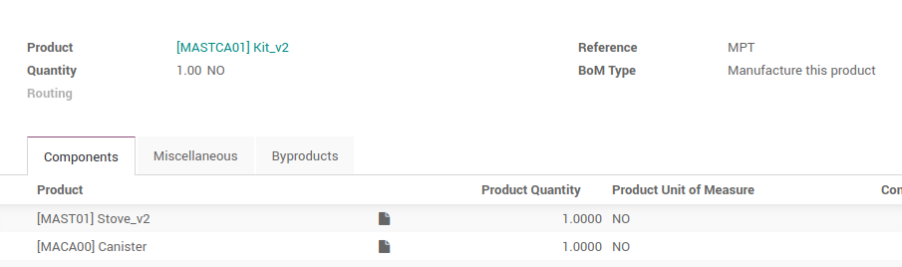
Current Version Management Process
The Version change in the KNI ERP is triggered from the third Party software based on the engineering change. Based on the change in the engineering drawing change the BOM in the KNI for the respective material is changed and the version of the BOM is managed by add some suffix in the product names [e.g. Kit_v2].

Slide 7
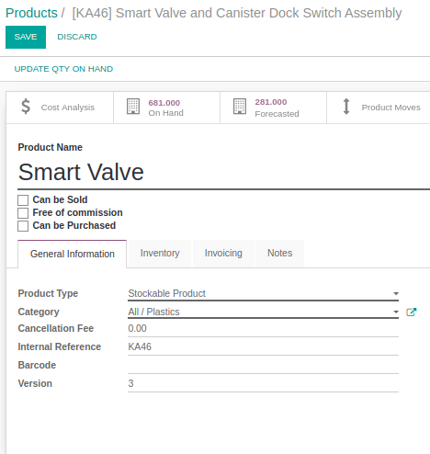
Versioning with PLM Process
PLM Module is the Odoo default functionality which is proposed to be used in the KNI System. Through this module we can record the BOM change history in the system, also the Version number is updated in the Product Master as can be seen in the image.

Slide 8
Queries
Based on the above BOM we have following openen points which needs to be agreed upon.
How we will define the version of a cooker Kit [Everytime we release a new version of Cooker or Canister]
How to set parameter to define the version of the product. [On what kind of Changes we will introduce a new version]
Can we change the Version of the Cooker and canister separately and still the Cooker Kit version can remain same.

Slide 9
Versioning In Kenya

Slide 10
Requirements in Kenya
In Kenya all the products are Imported from India. In Kenya the products are sold to the consumers and data is maintained in the ERP system. Maintaining the version of the system can be handy and useful in the following scenarios:
In the event of repair the service team can get the idea of the product the consumer is having in order to provide efficient service.
In case for retrofitting or changing the spare parts in the old cookers the tracking can be used to identify the cooker in the market for the change and the change history can be managed for the same.
We can analyse the stock of various versions in the Market.

Slide 11
Versioning in Kenya
In present process we do not manage the BOM of the product Manufactured in India in KNK ERP [e.g. Cooker and Canister], But we do manage the BOM of the items assembled in Kenya [e.g. KOKO Points]. So to conceptualise the versioning in KNK ERP we will have to take both the scenarios in account.
We need to have clarity on whether we need to have the versioning implementation for the products assembled in Kenya [As in long term the manufacturing of the KPs will be shifted to India]
Apart from KOKO points we also manage the BOM for the SDS which will be assembled in the Kenya. We need to get clarity from business whether we need to manage the versioning for the SDS in ERP or that is something we will be off the system as we are managing right now.

Slide 12
Versioning in Kenya
The major challenge in the versioning can be seen in the area of the products imported from india and sold in Kenya. We need to make a decision on how we need to manage the versioning in how to use the same in the future. In Kenya once the shipment is received the “consumer product tracker” record for the products are created and the customer record are updated in the same at the time of fulfillment.

Slide 13
Proposed Solutions

Slide 14
Implementation Approach
To automate change management in the BOM we can use the change management concept in the system.
The Product Tracker in KNI is created through the Manufacturing process itself so we can also add the Product BOM Version in the Product to specify what items are used to create the BOM.
The Information can be synced to the KNK system while creating the product tracker of the new products.
This process will be true for all the changes done in the products and tracking would be easy for all the future updates as well.
We can track the version of the BOM and also track the items replaced, added or removed for the BOM

Slide 15
Long Term Approach - Option 1
KNI ERP
KNK ERP
Change in the BOM Of Cooker:
Further Operations / Tracking can be managed Based on the BOM Version. Required Change Log can be Pulled from KNI system
BOM 1
Without Magnet Hatch
BOM 2
With Magnet Hatch
In KNI Product Tracker, we will record the BOM version, On creation through Manufacturing process
In KNK Product Tracker, we will receive all the information In KNK Product tracker.
Coker Serial : 2000xxxxx
Production BOM : BOM 2
Coker Serial : 2000xxxxx
Production BOM : BOM 2

Slide 16
New Approach and Mockups

Slide 17
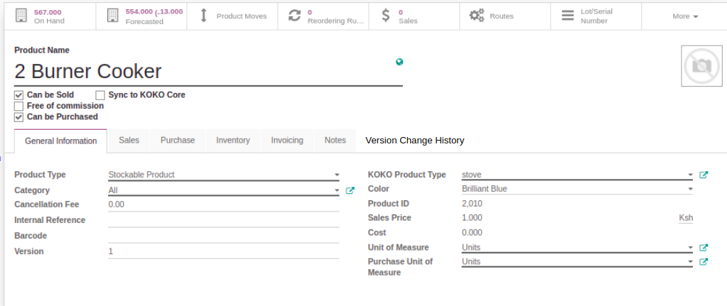
New Approach to manage the Versioning in KNK
In KNK as we want to manage the versioning without changing lot in the current process. We can have the following process:
Manage the Versioning in the Product Master
As shown in the below screen we can make a record in the KNK product Master. Including the changes we have introduced in the product, in the version change history tab.

Slide 18
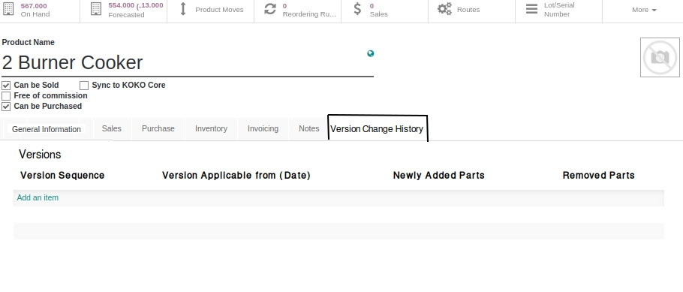
New Approach to manage the Versioning in KNK
In Version change history we can have following information included:
Version Sequence (Auto Generate)
Version Applicable on date
Added Parts
Removed Parts.

Slide 19
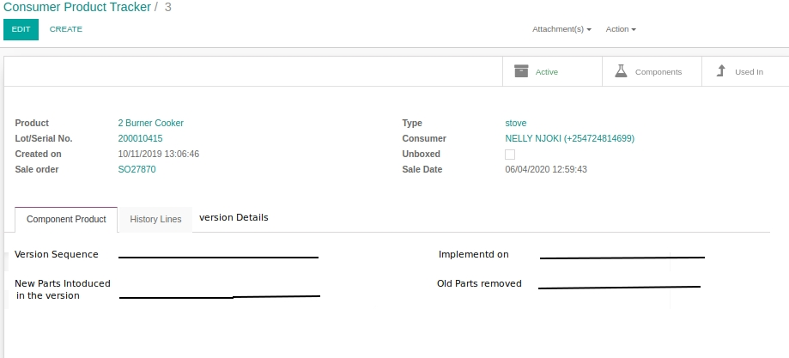
New Approach to manage the Versioning in KNK
Now at the time of GRN we can record the newest version details in the Consumer Product tracker as shown below: (We can also choose if we need to show less information)

Slide 20
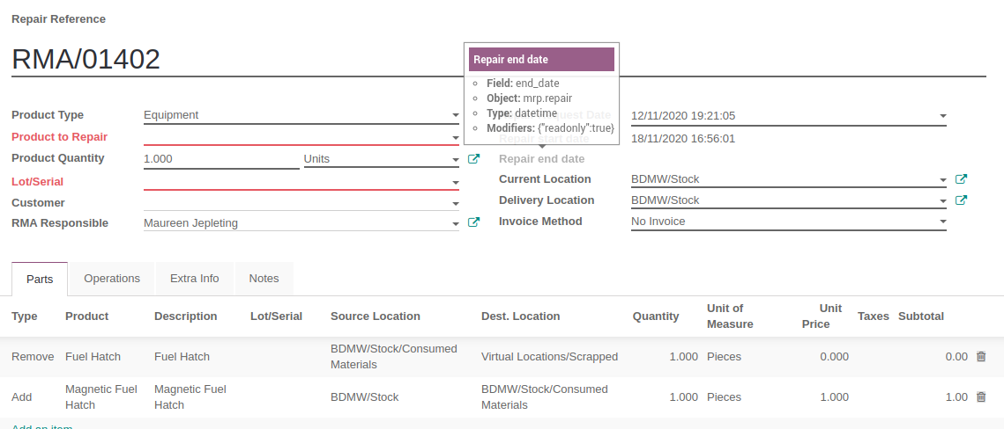
New Approach to manage the Versioning in KNK
Now in case of repairs currently we don’t have the option to change the version. But a better option can be if we maintain the history of the replaced items in the repair Orders:

Slide 21
New Approach to manage the Versioning in KNK
Once the repair is done we add the information in the “History Line” in product tacker that new product is added.

Slide 22
Thank You !!

